Slide 1
Introduction to Sensors

Slide 2
Definition
A sensor is a device that measures physical input from its environment and converts it into data that can be interpreted by either a human or a machine.

Slide 3
Comparison with Transducers
Both a sensor and a transducer are used to sense a change within the environment they are surrounded by or an object they are attached to.
A sensor will give an output in the same format and a transducer will convert the measurement into an electrical signal.

Slide 4
Classification of Sensors
Internal
Position (LVDT)
Velocity
Acceleration
Force (Strain Gauge)
External
Contact Type
Non-contact Type (Ultrasonic Sensor)

Slide 5
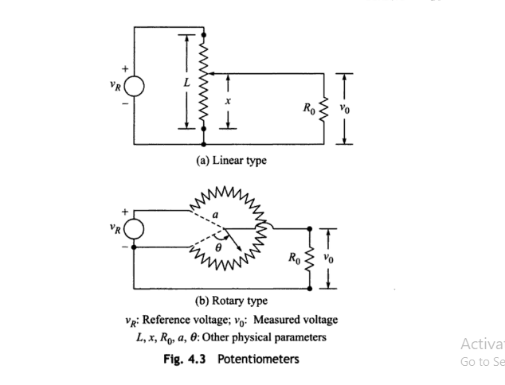
Potentiometer

Slide 6
Velocity Sensor
i) All Position Sensors
ii) Tachometer
iii) Half Effect Sensors

Slide 7
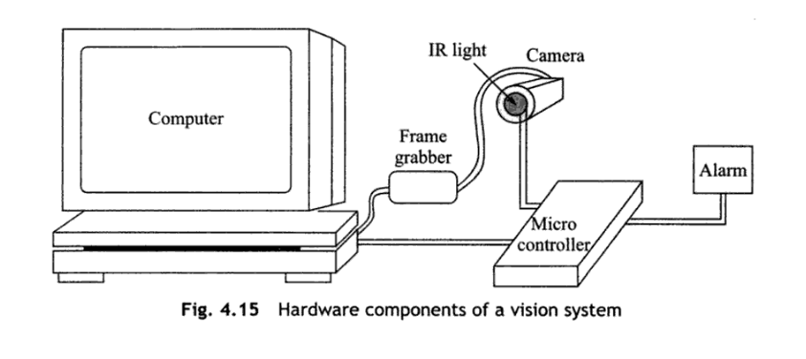
Vision System

Slide 8
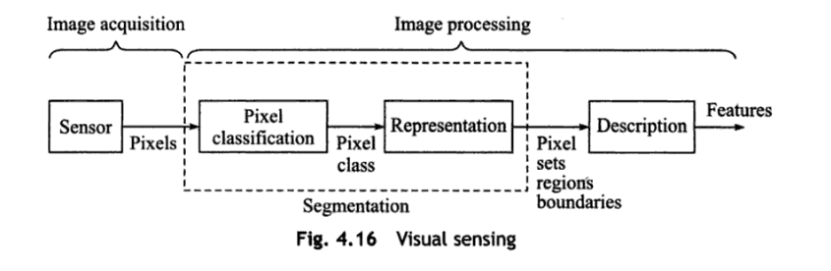
Steps in Vision Sensing

Slide 9
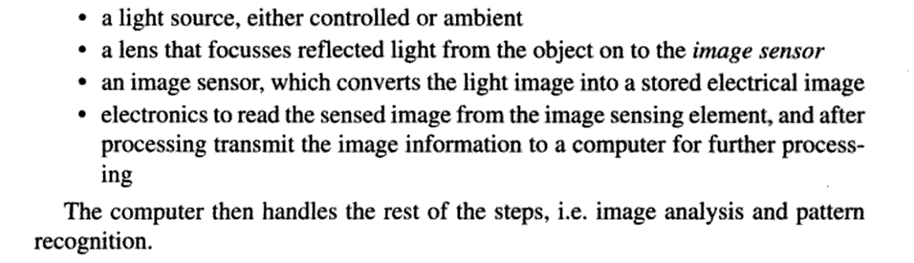
Image Acquisition

